Slide 1
USAID Carbon Offsets and Sequestration A Preliminary overview of Publicly Available data
Accountability Research Center (Homepage Link)
Jan. 29, 2025
Comments Welcome
E-mail: nc5628a@student.american.edu, jh1227a@american.edu

Slide 2
ARC Open Government Analysis
This sectoral review of USAID funding trends is part of ARC’s broader review of localization trends using open government tools (Project Page):
This pilot project:
Analyzes publicly available data from the International Aid Transparency Initiative (IATI) to take stock of USAID funding to carbon related projects
Applies USAID’s definition of “Direct Local Funding” to calculate sectoral localization percentages and trends
Other work in ARC’s open government review of USAID’s localization initiative includes:
A survey of USAID subaward data which finds widespread data quality and accessibility issues
Sectoral overviews of USAID’s land and indigenous rights portfolio, with a case study of projects in Colombia
A Localization Dashboard allowing for the interactive visualization of USAID’s self-reported localization data

Slide 3
USAID Carbon Sequestration and Carbon Offset Projects: Key Findings
Overall funding trends indicate a recent increase in USAID funding for projects related to Carbon Sequestration and Offsets
In 2023 USAID disbursed an estimated $61.5m in Carbon Sequestration and Carbon Offset related funding, a $43.7m (245%) increase from 2018 funding levels.
8 of the 10 largest projects were implemented by for-profit United States firms (ARD, Chemonics, and ICF International)
The percentage of direct local funding has decreased from 17.3% in 2018 to 2.9% in 2023
6.3% of disbursements ($25.7m) went to projects with local implementers between 2012–2023
Local prime contracts as a share of annual sectoral funding decreased from 11.4% in 2018 to 5.4% in 2023
Subawards were infrequently awarded to local organizations between 2012–2023
Of the top 3 projects by disbursement, 2 did not report any subawards (IFACS and Natural Wealth) and 1 reported $7.24m in subawards, all to non-local organizations (West Africa Biodiversity)
Carbon offsets are often monetarily small parts of larger sequestration projects
Large, multicomponent projects did not disclose exact funding allocations, making it impossible to disaggregate between carbon offset and carbons sequestration funding using public data
A lack of demand for carbon credits means that carbon offset projects largely struggled to generate meaningful funding streams through carbon stock sales

Slide 4
Carbon Offsets vs. Sequestration
USAID does not officially define Carbon Offset or Carbon Sequestration. For the purposes of this review, the following definitions were used:
Carbon Sequestration Project: Any project with a component that focuses on the capturing or storing of carbon in natural or artificial sinks. Includes projects with descriptions that explicitly mention: carbon sequestration, carbon sinks, ecosystem protections to cut carbon emissions, and decreasing carbon emissions from land usage.
Carbon Offset Project: Any project with a component that promotes the trade or sale of carbon stocks. Includes projects with descriptions that explicitly mention: carbon credits, carbon pricing, sale of carbon stocks, carbon trading, and carbon offsets. Also includes projects which fund the measurement and verification of carbon stocks for the purposes of generating tradeable credits in the future. Projects that met both the sequestration and offset definitions were classified as carbon offset projects.
For initial coding, all USAID projects with the keyword “carbon” were pulled from the International Aid Transparency Initiative (IATI) database then manually categorized using the above definitions.

Slide 5
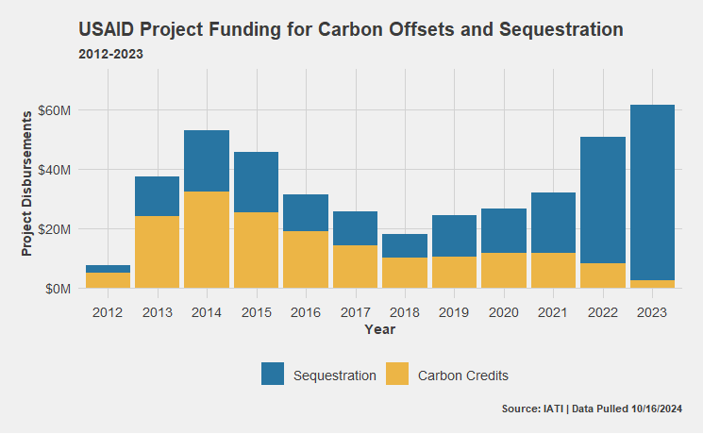
The USAID carbon project portfolio has shifted from an emphasis on carbon credits (peaking in 2014) to a primary emphasis on sequestration projects.
*Note: Carbon Credits/Offsets related funding captures all projects that explicitly mention carbon offsets, carbon credits, or carbon markets as a project component.

Slide 6
Top 5 Carbon Offset Projects by Total Disbursement
Project | Country | Implementing Partner | Disbursements | Carbon Offsets Issued | Year
Natural Wealth | Colombia | Chemonics | $38,374,144 | $250,000 | 2017 - 2024
MREDD | Mexico | The Nature Conservancy | $29,118,428 | No Report Found | 2011 - 2018
BIO-REDD+ | Colombia | Chemonics | $28,744,429 | 0* | 2011 - 2015
LEAD | Far East Asia, regional | ICF Int. | $18,464,401 | 0* | 2011 - 2017
LEAF | Far East Asia, regional | Winrock Int. | $15,634,443 | 0* | 2011 - 2016
Source: Disbursement figures and descriptive project information obtained from IATI (10/16/2024). Implementer information sourced from foreignassistance.gov. Carbon offsets figures sourced from project reports and evaluations.
*Note: Projects with $0 in issued carbon offsets justified their lack of measurable success as due to a lack of global demand for carbon credits. Due to a lack of demand for carbon credits, these projects invested in carbon market related infrastructure in anticipation of future demand, including the creation of carbon registries and baseline carbon measurement.

Slide 7
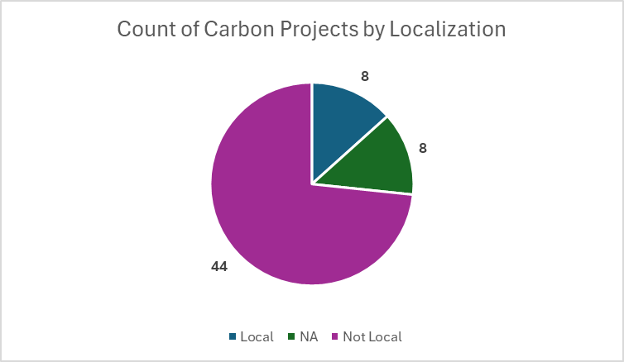
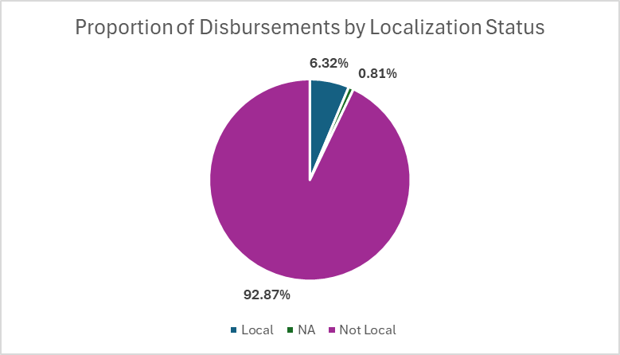
Localization: Carbon Sequestration and Offsets 2012 – 2023 | Localization Status of Prime Contractors*
Source: Disbursement figures and descriptive project information obtained from IATI (10/16/2024). Implementer information joined from foreignassistance.gov.
Note: Localization determinations based on USAID definitions of direct local funding

Slide 8
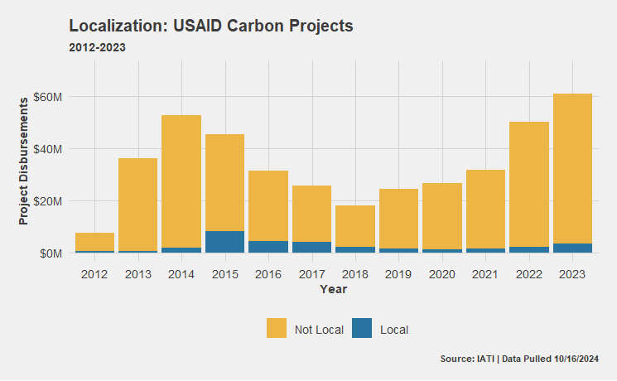
Note: USAID defines “local” as nationally constituted entities

Slide 9
Note: USAID defines “local” as nationally constituted entities

Slide 10
www.AccountabilityResearch.org
American University
School of International Service
4400 Massachusetts Ave. NW
Washington, DC 20016
Email: arc@american.edu
facebook.com/AcctResearchCtr/
@AcctResearchCtr

