Slide 1
USAID Subaward Data: Barriers to Public Access and Widespread Errors
Accountability Research Center (Homepage Link)
Draft (5/14/2024)
Comments Welcome
E-mail: jh1227a@american.edu, nc5628a@student.american.edu

Slide 2
USASpending Data Overview
USASpending is a primary source of subcontract and subaward USAID data
Reporting compliance to USASpending is part of USAID’s transparency obligations
Despite being a primary repository, the data is full of errors and duplicates
Site navigation requires a high level of technical expertise
The USAID USASpending data for this project covers:
1998-2023
71,888 total prime contracts, contract IDVs, and grants
61,412 total subawards*
Errors found in the data include:
7,904 duplicate subaward entries (12.9% duplication rate)
These duplicated entries are worth a cumulative $11,602,887,774
557 prime awards where subaward outlays exceeded total obligations
* Including duplicates subawards
Source: usaspending.gov (“Awarding Agency” – USAID; accessed October 9, 2023). All prime and subaward data for contracts, contract IDVs, and grants. Data available upon request: https://www.usaspending.gov/search/?hash=f4f6f85ad3c4594492f2810bf2ad944a

Slide 3
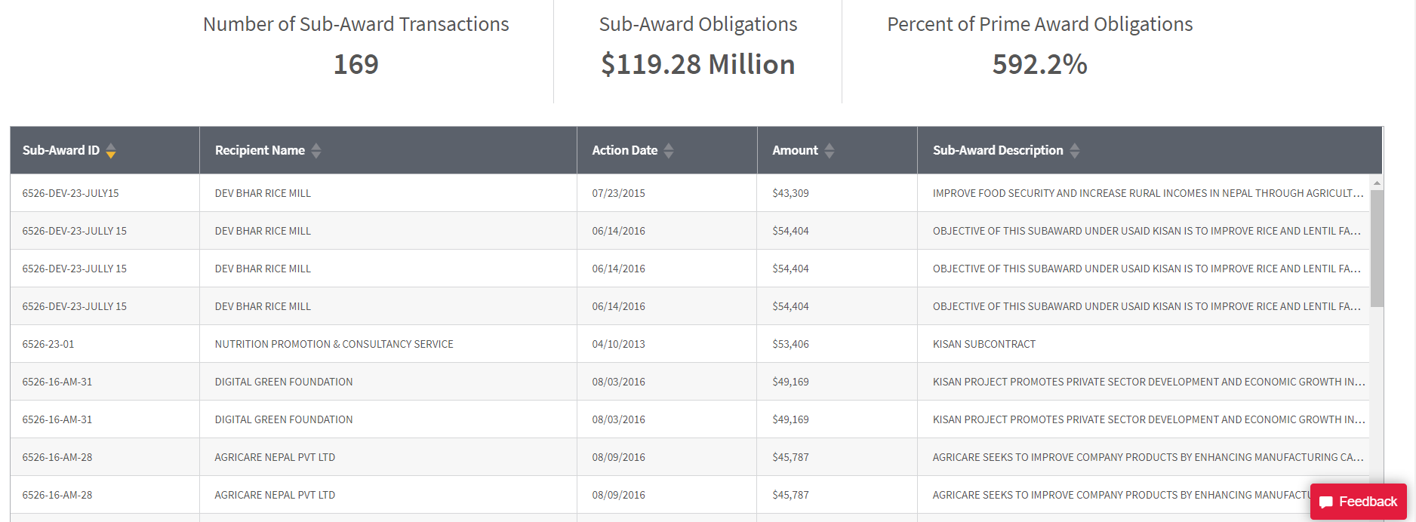
Examples of Erroneous Subaward Entries
Total subawards are substantially above prime awards due to duplicate subawards of the same amount, action date, and description.
Source: usaspending.gov (“Awarding ID” – AID367C1300004; accessed October 16, 2023). https://www.usaspending.gov/award/CONT_AWD_AID367C1300004_7200_-NONE-_-NONE-

Slide 4
Examples of Erroneous Subaward Entries
Erroneously large subaward (likely an attempt to enter the subaward ID as a dollar value) skews aggregated data and makes the total subaward statistic nearly unusable before substantial filtering. Although obvious at the individual award/contract level, these types of errors are particularly difficult to spot once data is aggregated.
Source: usaspending.gov (“Awarding ID” – 72065619CA00008; accessed October 16, 2023). https://www.usaspending.gov/award/ASST_NON_72065619CA00008_7200

Slide 5
Examples of Erroneous Subaward Entries
Subawards under the same contract appear to be coded for two different prime awards, the Youth Resilience Activity (YRA) and Indigenous Peoples and Afro-Colombian Empowerment Activity (IPACE). Several subawards appear on both the YRA and IPACE project pages.
Source: usaspending.gov (“Awarding ID” – 72065619CA00008; accessed October 16, 2023). https://www.usaspending.gov/award/ASST_NON_72065619CA00008_7200

Slide 6
USASpending Data Validation - GAO
The Government Accountability Office (GAO) has conducted several systemic audits of USASpending subaward data
GAO finds (reviewing government-wide subawards):
26% of grant subawards are duplicates*
14% of prime awards had subaward totals exceeding the prime contract total
The federal subaward reporting system lacks:
robust data validation
error checking
GAO also finds that expectations for subaward reporting were not clearly communicated to contractors, leading to an underreporting of subaward data that is undetectable by any existing auditing practice
GAO’s findings on USASpending data quality align with the data quality issues observed in the USAID specific USASpending data set analyzed in this report
Source: GAO-24-106237 and GAO-22-105427
Note*: This figure excludes subawards related to Covid-19-related funding

Slide 7
All Subaward Analysis is Provisional
Data used in this study has been cleaned to minimize known data quality issues with USASpending subaward data. Specifically:
All duplicate subawards were dropped from final calculations
All prime awards with subaward totals exceeding total outlays were dropped
All misc. and undisclosed prime awardees were dropped
All contracts with a total value below $25,000 were dropped to maintain consistency with the 2010 subaward reporting mandate
These measures minimize, but do not eliminate, USASpending’s known subaward data quality issues
Analysis is based on a best possible estimate of reported subaward data but cannot account for unreported subawards or undetected erroneous subawards
All analysis and conclusions in this study are provisional

Slide 8
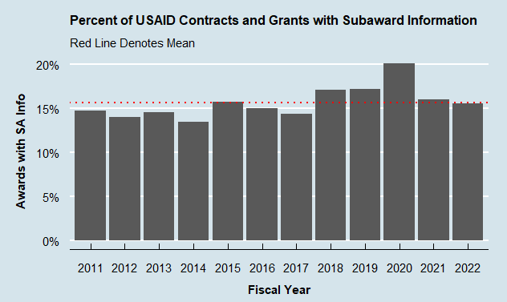
Source: usaspending.gov (“Awarding Agency” – USAID; accessed October 9, 2023). All prime and subaward data for contracts, contract IDVs, and grants. . Note: Dropped duplicate subawards, prime awards with total subawards exceeding total obligations and all misc. and undisclosed prime awardees. Data available upon request. https://www.usaspending.gov/search/?hash=f4f6f85ad3c4594492f2810bf2ad944a

Slide 9
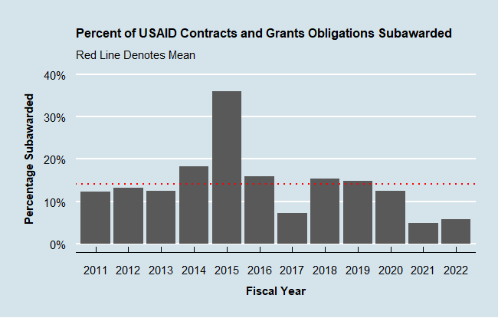
Source: usaspending.gov (“Awarding Agency” – USAID; accessed October 9, 2023). All prime and subaward data for contracts, contract IDVs, and grants. . Note: Dropped duplicate subawards, prime awards with total subawards exceeding total obligations and all misc. and undisclosed prime awardees. Data available upon request. https://www.usaspending.gov/search/?hash=f4f6f85ad3c4594492f2810bf2ad944a

Slide 10
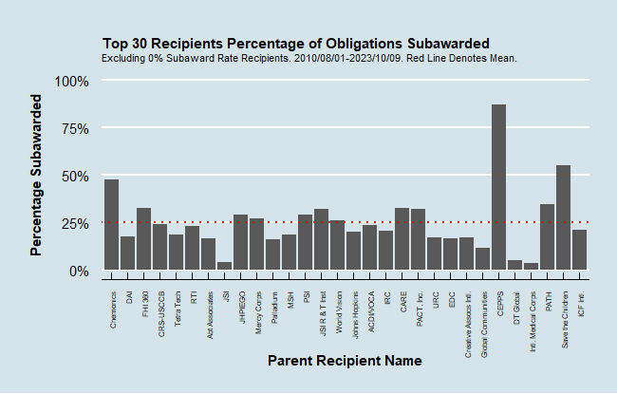
Source: usaspending.gov (“Awarding Agency” – USAID; accessed October 9, 2023). All prime and subaward data for contracts, contract IDVs, and grants. . Note: Dropped duplicate subawards, prime awards with total subawards exceeding total obligations and all misc. and undisclosed prime awardees. Data available upon request. https://www.usaspending.gov/search/?hash=f4f6f85ad3c4594492f2810bf2ad944a

Slide 11
Provisional Conclusions
USASpending is full of reporting errors resulting in unreliable data
The gap between reported USASpending subaward data and actual funds disbursed as subawards is impossible to assess
Subawards account for 14% of total obligations, indicating that most money stays “in house” with prime awardees
Larger recipients (top-30) generally had a higher proportion of total obligations accounted for by subawards at 25.2%
USAID’s indicators consider ‘local subawards’ as one of 14 best practices to contribute to locally led development
Public subaward data do not constitute a reliable metric to track this goal

Slide 12
www.AccountabilityResearch.org
American University
School of International Service
4400 Massachusetts Ave. NW
Washington, DC 20016
Email: arc@american.edu
facebook.com/AcctResearchCtr/
@AcctResearchCtr

