Slide 1
U.S. Foreign Assistance to Tanzania A Preliminary overview of Publicly Available data
Accountability Research Center (Homepage Link)
Draft (9/25/2023)
Comments Welcome
E-mail: jh1227a@american.edu, nc5628a@student.american.edu

Slide 2
USAID Tanzania: Fact sheet overview
USAID Tanzania’s website provides 80 fact sheets covering active and recently closed projects
57 fact sheets cover individual projects
23 fact sheets provide overviews of specific issue areas or long-term USAID initiatives encompassing multiple projects (e.g., Vaccination)
N = 80
Source: https://www.usaid.gov/tanzania (“Factsheets”; accessed September 19, 2023).: https://www.usaid.gov/tanzania/fact-sheets
*Note: Includes both project and non-project fact sheets. 80 total fact sheets, 27 with translations accessible on USAID website.

Slide 3
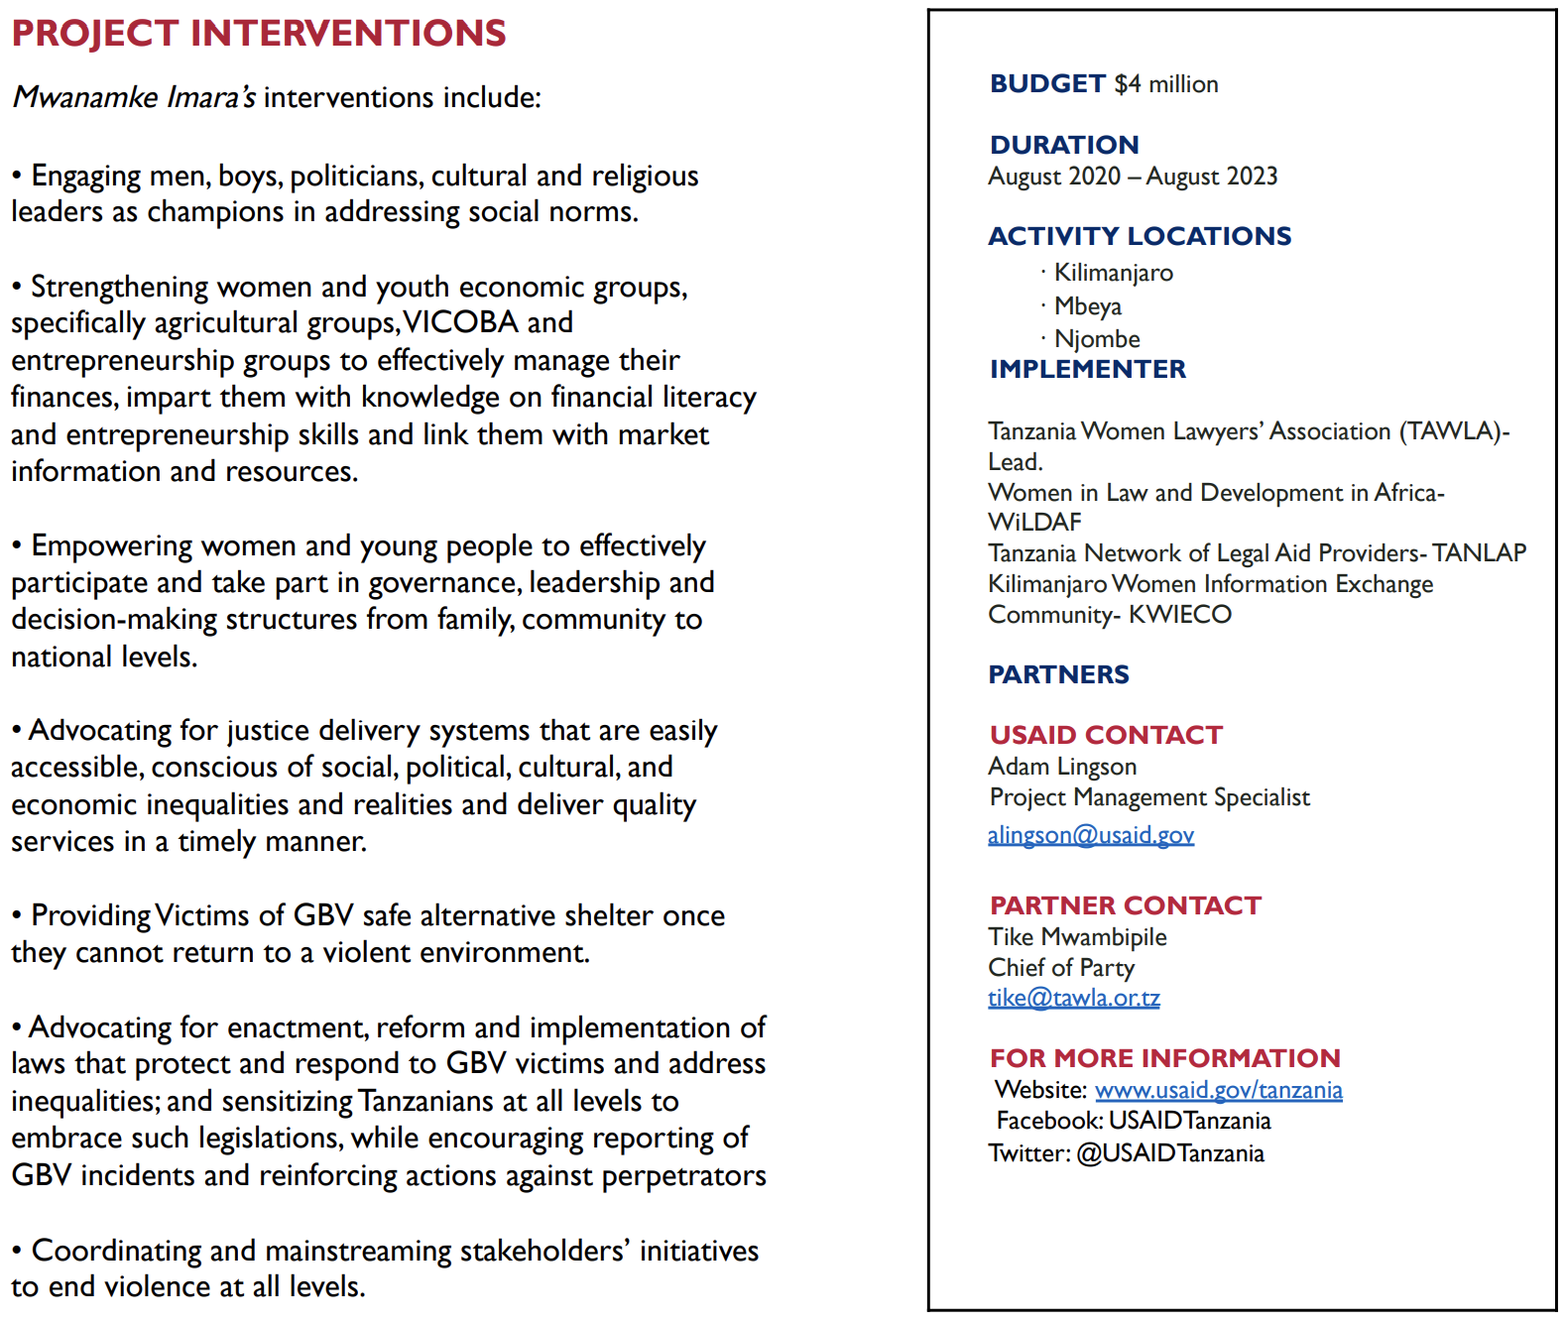
USAID Tanzania: Fact sheet formatting
USAID Tanzania fact sheets generally display key project information in an easily accessible manner
Most fact sheets provide consistent formatting, with key project information clearly summarized in a text box
The 2023 Activity Briefer Fact Sheet provides paragraph length summaries of ongoing projects (including those without individual fact sheets)
Swahili-translated versions were provided for 27 (33.8%) of 80 available fact sheets
Sample image from the Mwanamke Imara (“A StrongWoman”) fact sheet, showing the common format used by USAID Tanzania to provide relevant project information
Source: https://www.usaid.gov/tanzania (“Factsheets”; accessed September 19, 2023).: https://www.usaid.gov/tanzania/fact-sheets

Slide 4
USAID Tanzania fact sheets: Open government indicators
Source: https://www.usaid.gov/tanzania (“Factsheets”; accessed September 19, 2023).: https://www.usaid.gov/tanzania/fact-sheets
Note*: Clearly identified means that an organization was explicitly stated to be an “implementing partner”. Statement’s embedded in the text body and containing ambiguous language (e.g. USAID worked with the President’s Malaria Initiative) were not considered clear identifications.

Slide 5
Category name
Source: https://www.usaid.gov/tanzania (“Factsheets”; accessed September 19, 2023).: https://www.usaid.gov/tanzania/fact-sheets
Note* Funding is based on the project period funding listed on USAID Tanzania factsheets, which may differ from actual disbursed or allocated funding. Two fact sheets (Global Health Supply Chain Program Factsheet and The President’s Malaria Initiative Factsheet) listed funding for fiscal year and not project period and were thus excluded. The project amounted to roughly $130m in annual funding.

Slide 6
USAID localization: Tanzania FY2021-2022
USAID set a minimum 25% global target for direct funding for national implementing partners by 2025 (starting from 8.1% in 2020). In 2022, USAID reported a global average of 10.2%
Country targets vary, with a higher than 25% share expected in countries where national organizations have higher capacity to manage USAID projects
USAID Tanzania fell short of the USAID global target in 2021 with a 20.7% direct local funding share, followed by a slight drop to 19.2% in 2022
Source: USAID, “Moving Toward a Model of Locally Led Development,” July 2023, https://www.usaid.gov/localization/fy-2022-localization-progress-report

Slide 7
USAID funding trends in Tanzania: Findings
Half of all US foreign assistance to Tanzania is for health-related projects
Between 2015-2022, health-related projects received 69% of the budget or more each year
Economic development-related projects accounted for 30% of the total budget between 2012-2014, but only for 10% between 2015-2022
USAID’s funding priorities match general trends from all agencies, with annual budgets focused on health and economic development
USAID’s budget is mostly consistent year-over-year with a fully reported low of $315,243,660 in 2016 and a high of $429,363,726 in 2018

Slide 8
U.S. Category names
Source: ForeignAssistance.gov (“Disbursements” – Tanzania; accessed September 18, 2023).: https://www.foreignassistance.gov/data#tab-query
*Note: Public data is reported as not complete for FY2022.

Slide 9
Source: ForeignAssistance.gov (“Disbursements” – Tanzania; accessed September 18, 2023).: https://www.foreignassistance.gov/data#tab-query
*Note: Public data is reported as not complete for FY2022.

Slide 10
Total Amount in USD
Source: ForeignAssistance.gov (“Disbursements” – Tanzania; accessed September 18, 2023).: https://www.foreignassistance.gov/data#tab-query
*Note: Public data is reported as not complete for FY2022.

Slide 11
www.AccountabilityResearch.org
American University
School of International Service
4400 Massachusetts Ave. NW
Washington, DC 20016
Email: arc@american.edu
facebook.com/AcctResearchCtr/
@AcctResearchCtr

